Slide 1
Uninformed search.

Slide 2
1. Breadth-first search
The root node is expanded first, then all the nodes generated by the root node are expanded next, and then their successors, and so on.
In general, all the nodes at depth d in the search tree are expanded before the nodes at depth d + 1.
If there is a solution, breadth-first search is guaranteed to find it, and if there are several solutions, breadth-first search will always find the shallowest goal state first.

Slide 3

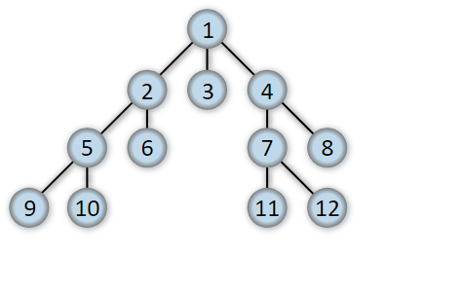
Total number of nodes in a complete tree?

Slide 4
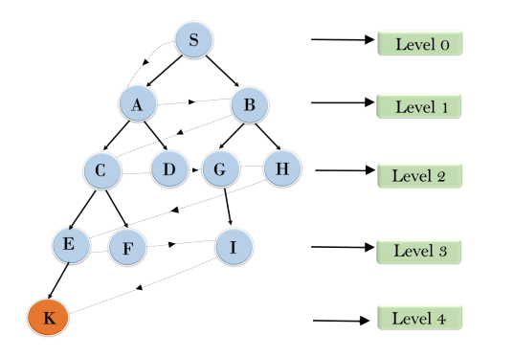
BFS algorithm from the root node S to goal node K
S---> A--->B---->C--->D---->G--->H--->E---->F---->I---->K

Slide 5
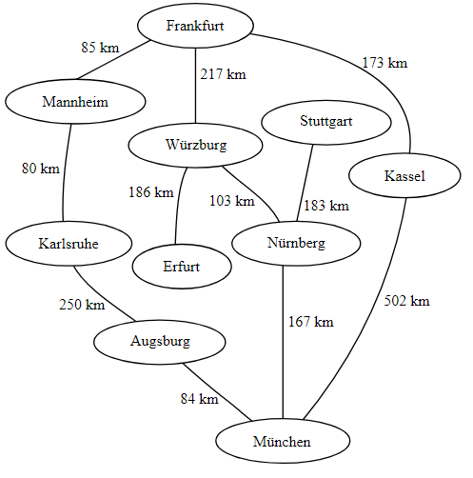
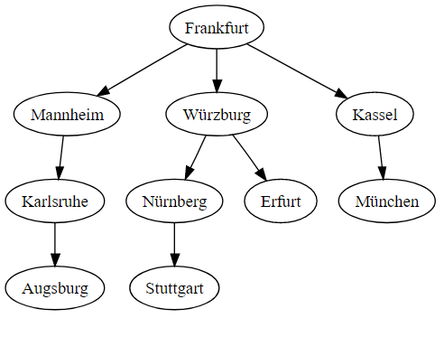
Breadth-first tree obtained by running a BFS on German cities starting from Frankfurt:

Slide 6
BFS is implemented using FIFO queue data structure.
Advantages:
BFS will provide a solution if any solution exists.
If there are more than one solutions for a given problem, then BFS will provide the minimal solution which requires the least number of steps.
Disadvantages:
It requires lots of memory since each level of the tree must be saved into memory to expand the next level.
BFS needs lots of time if the solution is far away from the root node.

Slide 7
Evaluation of BFS
Time Complexity: Time Complexity of BFS algorithm can be obtained by the number of nodes traversed in BFS until the shallowest Node. Where the d= depth of shallowest solution and b branching factor.
T (b) = 1+b+b²+b³+.......+ b^{d}= O (b^{d})
Space Complexity: Space complexity of BFS algorithm is O(b^{d}).
Completeness: BFS is complete, which means if the shallowest goal node is at some finite depth, then BFS will find a solution.
Optimality: BFS is optimal if path cost is a non-decreasing function of the depth of the node.

Slide 8
2. Uniform cost search
Uniform-cost search is a searching algorithm used for traversing a weighted tree (different cost is available for each edge) or graph.
The primary goal of the uniform-cost search is to find a path to the goal node which has the lowest cumulative cost.
Uniform-cost search expands nodes according to their path costs form the root node to find optimal cost.
Uniform-cost search algorithm is implemented by the priority queue.
Uniform cost search is equivalent to BFS algorithm if the path cost of all edges is the same.

Slide 9
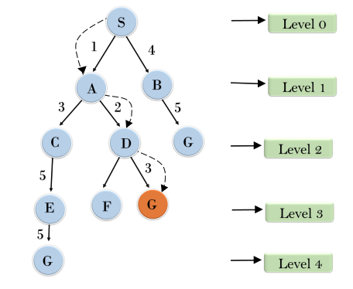

Slide 10
Advantages:
Uniform cost search is optimal because at every state the path with the least cost is chosen.
Disadvantages:
It does not care about the number of steps involve in searching and only concerned about path cost. Due to which this algorithm may be stuck in an infinite loop.
Completeness: Uniform-cost search is complete, such as if there is a solution, UCS will find it.
Optimal: Uniform-cost search is always optimal as it only selects a path with the lowest path cost.

Slide 11
3. Depth-first search
Depth-first search always expands one of the nodes at the deepest level of the tree.
Only when the search hits a dead end does the search go back and expand nodes at shallower levels.
Stack function is used to represent DFS.
Depth-first search has very modest memory requirements.

Slide 12
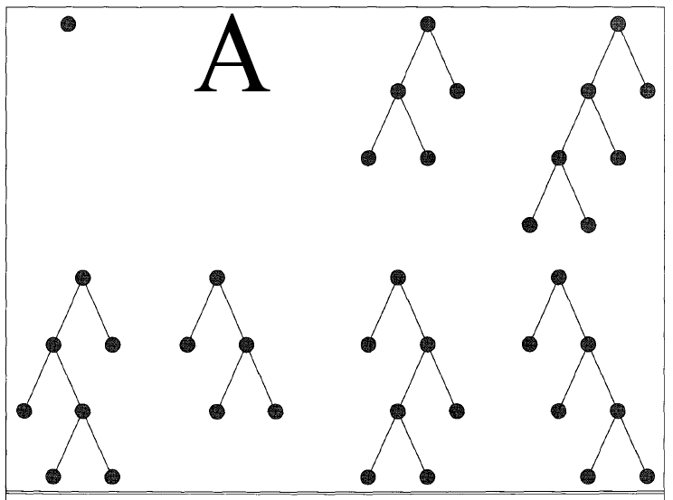
Depth-first search trees for a binary search tree.

Slide 13
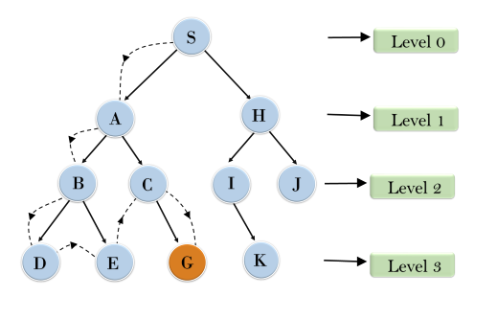
Traversing technique (Root node--->Left node ----> right node)

Slide 14
Advantage:
DFS requires very less memory as it only needs to store a stack of the nodes on the path from root node to the current node.
It takes less time to reach to the goal node than BFS algorithm (if it traverses in the right path).
Disadvantage:
There is the possibility that many states keep re-occurring, and there is no guarantee of finding the solution.
DFS algorithm goes for deep down searching and sometime it may go to the infinite loop.

Slide 15
Evaluation of DFS
Completeness: DFS search algorithm is complete within finite state space as it will expand every node within a limited search tree.
Time Complexity: Time complexity of DFS will be equivalent to the node traversed by the algorithm. It is given by:
T(n)= 1+ n+n²+ n³ +.........+ n^{m}=O(n^{m})
Where, m= maximum depth of any node and this can be much larger than d (Shallowest solution depth)
Space Complexity: DFS algorithm needs to store only single path from the root node, hence space complexity of DFS is equivalent to the size of the fringe set, which is O(bm).
Optimal: DFS search algorithm is non-optimal, as it may generate a large number of steps or high cost to reach to the goal node.

